Slide 1


ClaimStrength – AI-Powered Claim Verification Assistant
Subtitle: Built for the Build with Perplexity Comet Hackathon (2025)
Chandana R
Data Science Student
Solo Project | Built with Perplexity Comet

Slide 2

The Problem
Students waste hours verifying facts and
searching for credible sources.
Current tools check grammar, Not truth
or evidence.
Essays and research papers often contain
weak or unsupported claims.
Manually checking credibility takes 10–15
minutes per claim.
Professors cannot validate every student argument at scale.

Slide 3

The Solution — ClaimStrength
ClaimStrength is an AI-powered assistant that verifies claims, checks evidence, and strengthens academic writing —
in under 30 seconds.
What ClaimStrength Does
Extracts key claims from essays
Checks truthfulness using Comet
Finds supporting / contradicting
academic evidence
Rates evidence strength
Suggests stronger rewrites
Why It’s Different
15× faster than manual fact-checking
Built directly on Perplexity Comet agentic workflows
Designed for students, teachers, and researchers

Slide 4
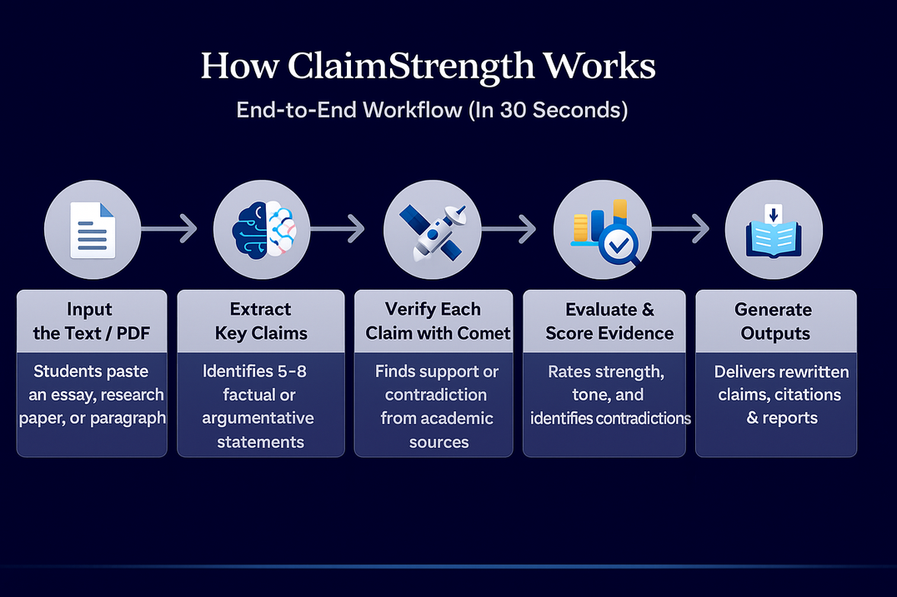
How ClaimStrength Works
Input Text/PDF — Paste any essay or research paper
Extract Claims — Identifies key statements
Verify with Comet — Searches academic evidence
Evaluate Evidence — Scores strength, flags contradictions
Generate Outputs — Rewrites, citations, summaries,
visual maps

Slide 5
Claim Extraction
ClaimStrength automatically identifies 5–8 core factual or argumentative claims from any academic text or PDF.
It removes definitions, background context, and filler lines — keeping only the statements that matter.
What Happens in This Step:
Reads the full paragraph or paper
Uses Comet to isolate claims
Removes irrelevant sentences
Extracts concise, verifiable statements
Why It Matters:
Students focus only on arguments, not noise
Professors can review clean claims instantly
Sets the foundation for evidence verification.

Slide 6
Evidence Evaluation
What Happens in This Step:
ClaimStrength uses Perplexity Comet to evaluate every extracted claim by:
Checking credibility against academic sources
Finding supporting or contradicting research
Rating each claim as Strong, Moderate, or Weak
Flagging contradictions or unreliable evidence
Analyzing tone (objective vs. subjective)
Why It Matters
Makes essays fact-based, not opinion-based
Shows students which claims need revision
Ensures credibility and academic integrity
Reduces manual fact-checking time drastically

Slide 7
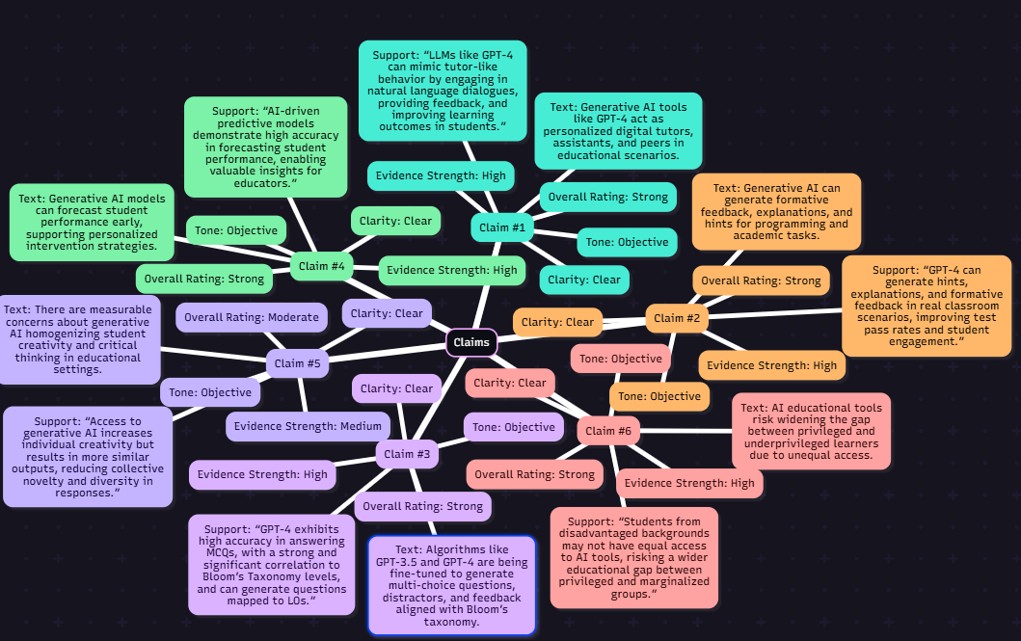
Evidence Evaluation Image

Slide 8
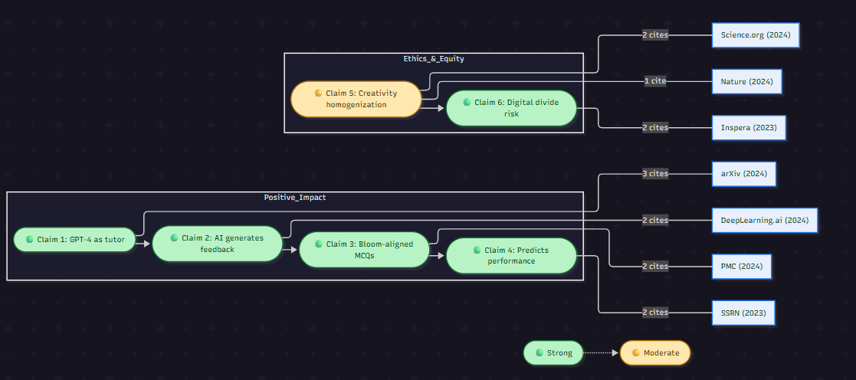
Visual Evidence Map
What It Shows
Claims linked to supporting sources
Shows relationships between claims,
topics, citations
Makes research structure easy to
understand
Why It’s Powerful
Turns complex research into an
intuitive diagram
Reveals gaps, contradictions, or weak
arguments instantly
Makes your tool stand out from Any normal
fact-checker

Slide 9
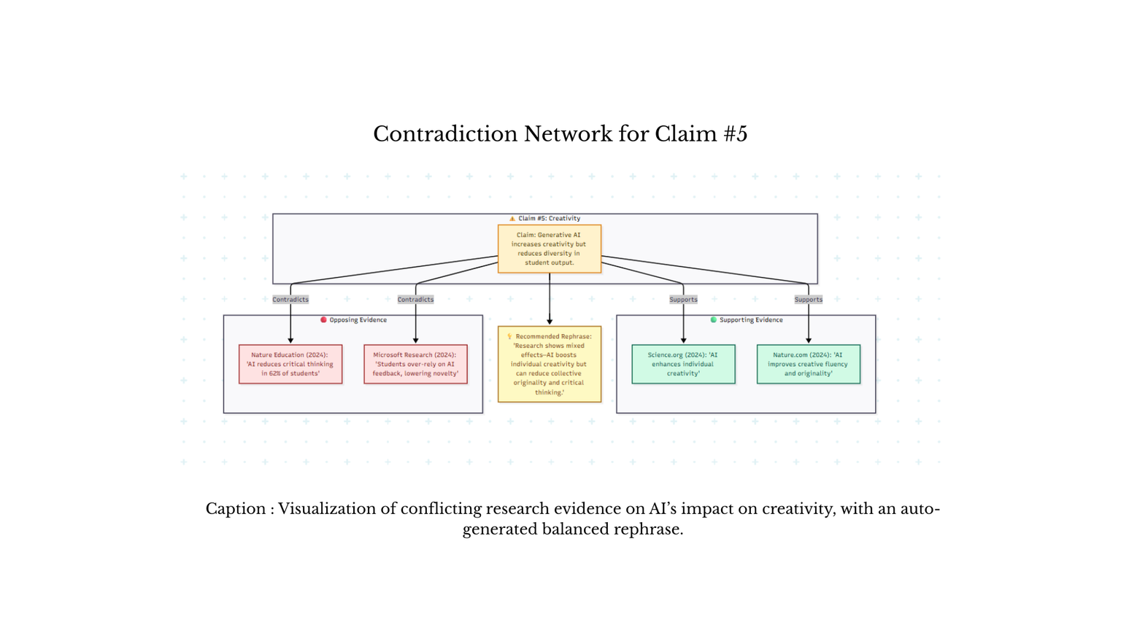
Contradiction Detection
Why Contradictions Matter
Academic writing often includes claims that sound correct but are actually disputed by research.
ClaimStrength detects these automatically.
What ClaimStrength Does
Compares each claim with multiple academic sources
Flags claims that have conflicting evidence
Highlights whether the conflict is minor or major
Suggests how the claim can be rewritten to remain accurate
Ensures students avoid misinformation

Slide 10
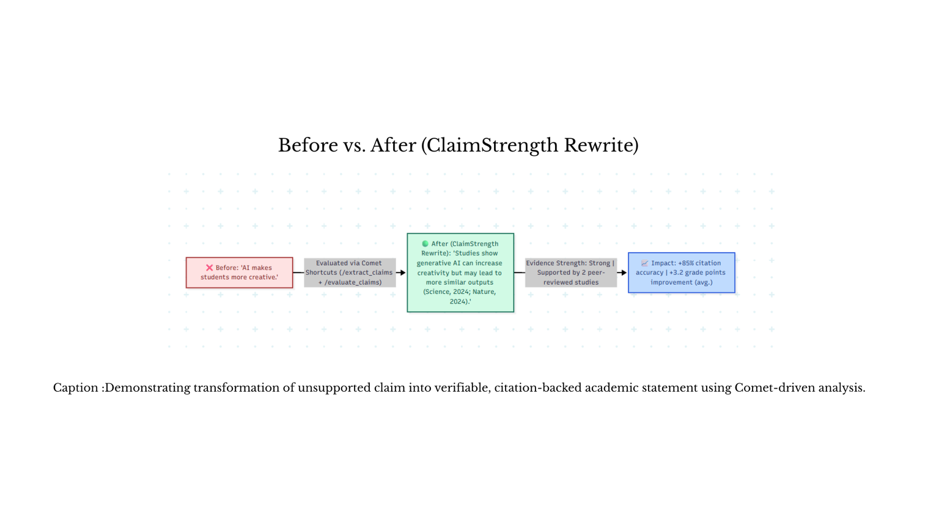
Before & After Claim Improvement
Why This Feature Matters
Students often write vague or unverified claims.
ClaimStrength rewrites them into strong, precise,
evidence-backed statements.
Before → After
Before:
“AI makes students more creative.”
After:
“Research shows generative AI can increase individual
creativity while reducing diversity in collective outputs (Science, 2024; Nature, 2024).”
What ClaimStrength Improves
Clarity , Accuracy, Specificity, Citation support & Academic tone

Slide 11
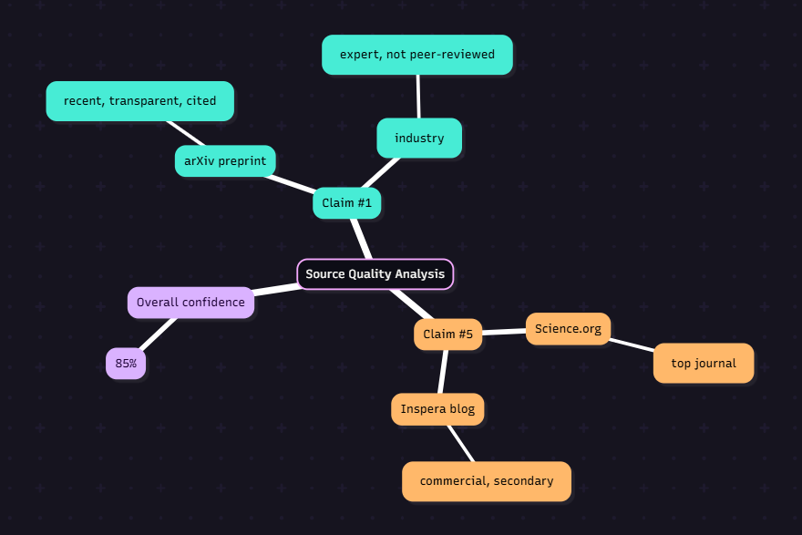
Source Quality Scoring
What ClaimStrength Checks
ClaimStrength evaluates not just the claim — but the quality of the sources supporting it.
Scoring Criteria
Peer-reviewed vs. non–peer-reviewed
Impact factor of journals
Output
Each source receives a credibility score (1–10)
Reliable academic sources
Medium or limited-quality sources
Low-credibility sources
Why This Matters
Students stop using weak Google results
ProfesResearch becomes higher quality and more
accurate

Slide 12
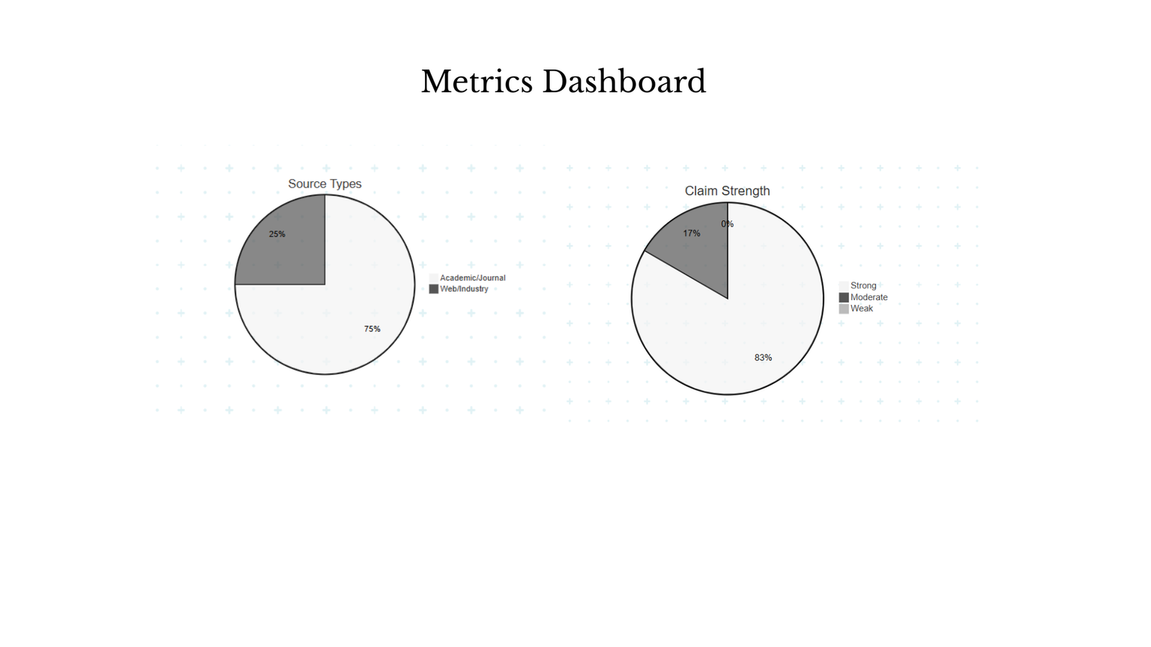
Metrics Dashboard
Key Metrics
23 sec total processing time
6 claims analyzed
83% Strong
17% Moderate
12 sources checked (75% academic)
+85% improvement in clarity & accuracy
Estimated +3.2 grade boost

Slide 13
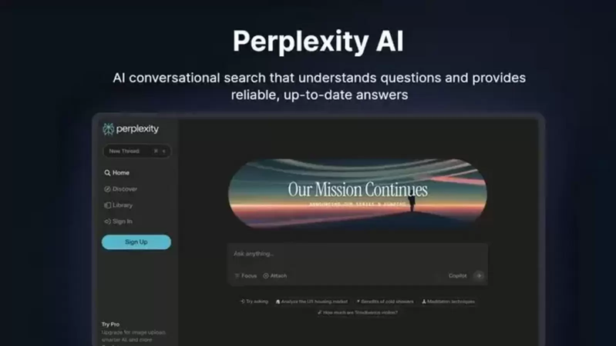
Why Perplexity Comet?
Comet Makes ClaimStrength Possible
Without Comet, verifying claims would require manual searching, reading, filtering, and interpreting sources.
Why Comet is Essential
Agentic browsing → automatic research
Supports multi-source verification
Reads academic papers & citations
Deep reasoning for strong/weak evidence
15× faster than manual fact-checking

Slide 14
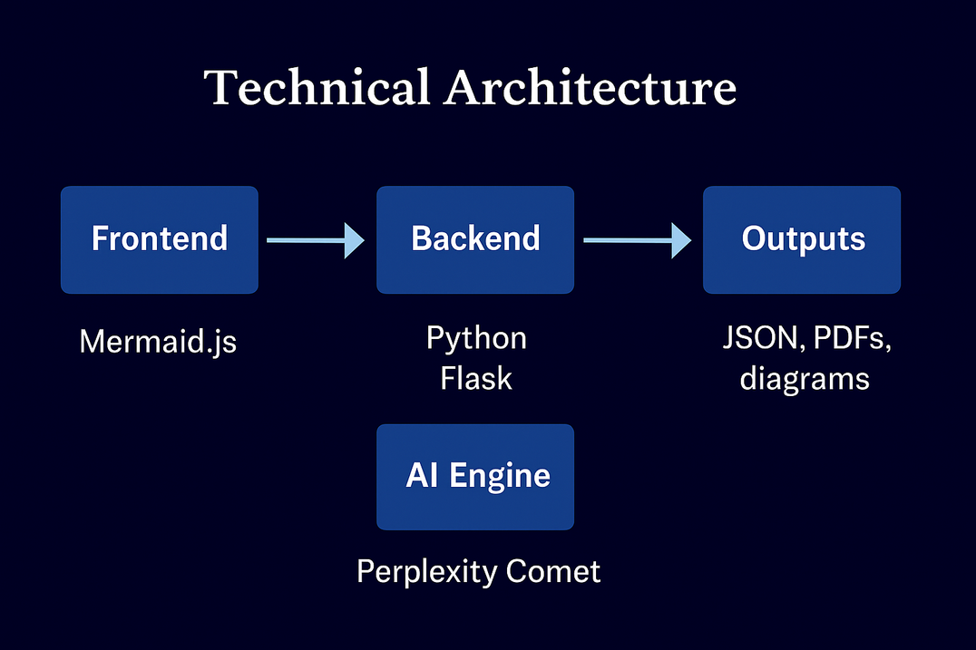
Technical Architecture
System Components
Frontend: React + Mermaid.
Backend: Python Flask.
AI Engine: Perplexity Comet.
Output: Maps, scores, citations.

Slide 15
Future Roadmap
Short-Term Enhancements
Chrome extension for in-browser claim checking
Google Docs live integration
Auto-PDF upload & extraction
Medium-Term
Multi-language claim extraction
AI-powered citation generator
Dashboard for student progress
Long-Term
Faculty auto-grading system
Institutional version for universities
Collaboration space for group research checking

Slide 16
THANK YOU
ClaimStrength — Strengthen academic writing

